Slide 1
2. Introduction to Organization and Organization Environment

Slide 2
Contents
What is an organization?
What is a business organization?
Classification of business organizations
Organizational Environment
SWOT Analysis in Organizational Environment
Corporate Social Responsibility
Stakeholders of an Organization

Slide 3
What is an Organization ?

Slide 4
An Organization - Definitions
A group of people who work together in a structured way for a shared purpose.
(Cambridge Advanced Learners Dictionary)
An organisation is a collection of two or more people who work together in a structured way to achieve a specific goal or set of goals.
(Stoner and Freeman,2009)
An organization is a deliberate arrangement of people to accomplish some specific purpose.
(Robbins and Coulter, 2007)

Slide 5

Common Features of an Organization
People
Structure
Common objective/goal
(Robbins and Decenzo,2004)

Slide 6
Business Organization
A business organization is a collection of individuals and deliberately structured entity which produces goods and/or services utilizing limited resources to achieve its specific goals and objectives.
Apply to all organizations: for profit, non-profit and not-for -profit.

Slide 7
Bases for Classification of Business Organisations
Objective
Product
Ownership
Scale
Stage of Production
Legal Structure
Liability
Technology
Market

Slide 8
Objectives of Business Organizations
What is an objective?
Objectives are those end results toward which the organizational activities are directed.
(Koontz and Donnel)
Classification of objectives
Objectives can be classified based on the level of significance and time horizon.
Multiple objectives of an organisation

Slide 9
Stakeholders and their multiple objectives
Trade
Unions
Political
Parties
Customers
General
Community
Media
Debtors
Employees
Business
Organisations
Competitors
Suppliers
Owners
Educational
Institutions
Government
Creditors
Customers
Financial Institutions
Trade Associations

Slide 10
Stakeholders The people or groups that supply a company with its productive resources and so have a claim on and stake in the company. Individuals, groups or institutions directly or indirectly affected by the activities of the organisation and who have an interest over it.
(Jones and George, 2009)

Slide 11
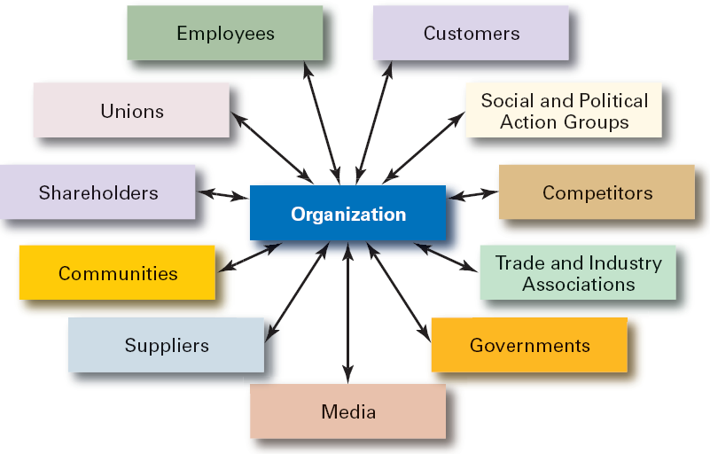
Types of Stakeholders
(Robbins and Coulter ,2010)

Slide 12
Organizational Environment
Organizational Environment is a set of forces surrounding an organisation that have the potential to affect the way it operates and its access to scare resources.
(Jones, 2007)
Organizational Environment is the sum totality of all the internal and external factors and forces affecting the organizational performance.

Slide 13
Classification of Organizational Environment
Internal Environment
External Environment
Macro/General Environment
Micro/Task Environment

Slide 14
Classification of Organizational Environment
Global Environment
Macro Environment
Economic Environment
Inflation, Interest Rate, Budgetary and Monetary Policies
Task Environment
Internal
Environment
Goals
Leadership Culture
Processes
Political Environment
Political Structure of the economy,
Civil Wars, Class Struggle
Bankers
Government
Socio-Cultural Environment
Demographic Structure, Ethnic Structure
Customers Competitors Suppliers
Technological Environment
Acquisition and Development of Information Technology , Communication and Manufacturing Technology

Slide 15
Internal Environment
Internal environment includes the elements within the organization's boundaries, composed of current employees, structure, culture, technology, leadership, resources, etc.

Slide 16
External Environment
The external organizational environment includes all elements existing outside the boundary of the organisation that have the potential to affect the organisation.

Slide 17
External Environment
The macro/general environment is the outer layer that is widely dispersed and affects organizations indirectly. It includes economical, social, technological, political and legal and natural.
The micro/task environment is closer to the organisation and includes individuals, groups and institutions directly influencing organization's basic operations and performance. It generally includes competitors, suppliers, customers, labor market, financial institutions, etc.

Slide 18
SWOT Analysis in Organizational Environment
A careful analysis of organizational environment is necessary to diagnose SWOT (Strengths, Weaknesses, Opportunities and Threats).
The objective of internal analysis is to identify the strengths and weaknesses and external analysis is to identify opportunities and threats to build competitive advantages to high performance of an organisation.

Slide 19
Environmental Analysis
 | Internal | External
Favourable | Strengths | Opportunities
Unfavourable | Weaknesses | Threats
Environment
Effect

Slide 20
Evolving Nature of the Business Environment
Up to 1915 : Almost Stable Business Environment
1915 – 1960 : Changing Business Environment
1960 - 1990 : Dynamic Business Environment
After 1990 : Turbulent Business Environment

Slide 21
Organisation-Environment Relationship
Main factors that decide the nature of the organisation-environment relationship.
Environment turbulence
Environmental uncertainty and
Competitive forces
Thus, environment is one of the leading contingencies that every organisation should plan and/or adapt.

Slide 22



Corporate Social Responsibility and Ethics as means of strengthening the relationship between organisation and its environment.

Slide 23
Corporate Social Responsibility The way a company’s managers and employees view their duty or obligation to make decisions that protect, enhance and promote the welfare and well-being of stakeholders and society as a whole.
(Jones and George, 2009)

Slide 24
How an Organization can achieve CSR? ( Source: Archie B. Carroll, “The Pyramid of Corporate Social Responsibility: Toward the Moral Management of Organizational Stakeholders,” Business Horizons (July-August 1981) © 1991 by the Foundation for the School of Business at Indiana University. )
Philanthropic Responsibilities Be a good corporate citizen.
Ethical Responsibilities Be ethical.
Legal Responsibilities Obey the law.
Economic Responsibilities Be profitable.

Slide 25
Practice of CSR activities in today’s Organizations

Slide 26
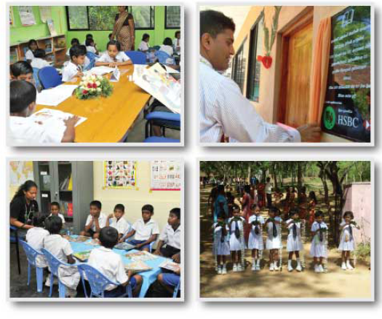
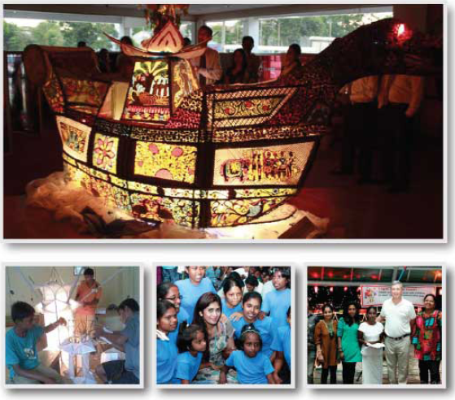
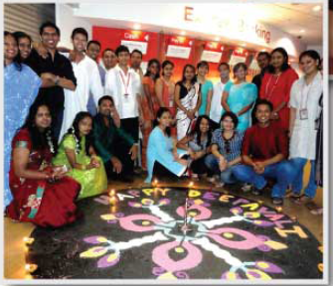
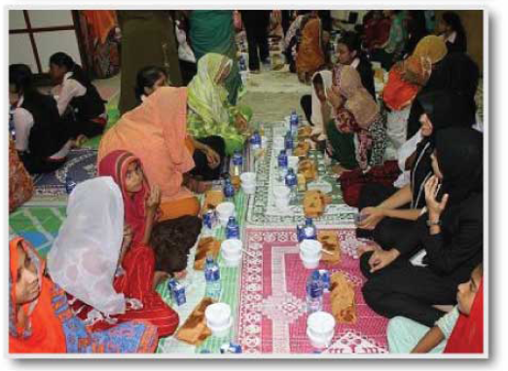
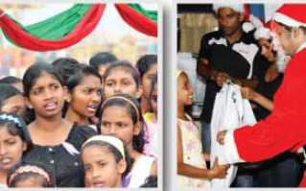
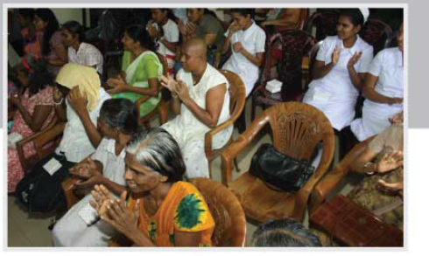


(http://www.hsbc.lk/1/PA_ES_Content_Mgmt/content/about_us/csr/cb_booklet.pdf)

Slide 27
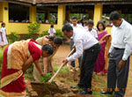
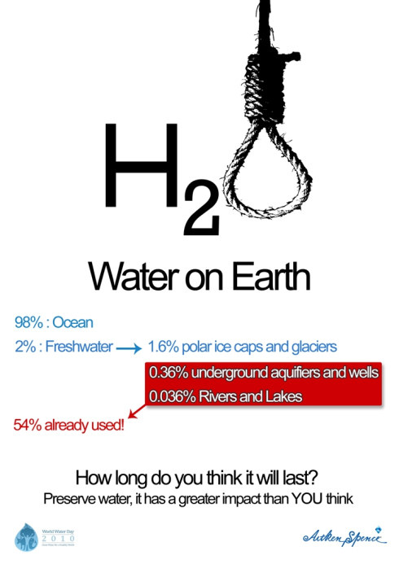
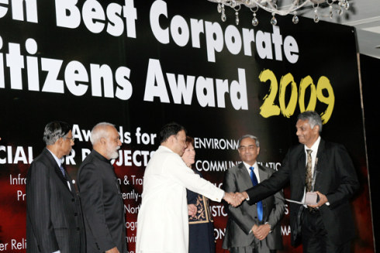
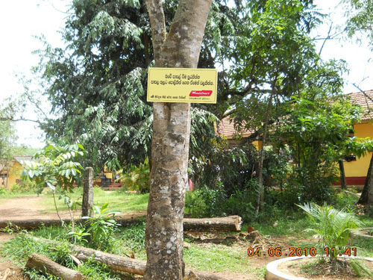


(http://aitkenspenceplc.wordpress.com/tag/aitken-spence-csr/)
(http://www.malibanbiscuit.com/csr)
(http://www.dsi.lk/news/dsi/20120329124815/DSI_50th_Anniversary_Celebration_CSR_Project_@_Galle.php)

